Slide 1
Agent-Based Modelling
Computational Social Science
Workshop 9

Slide 2
Outline
Work with a simple NetLogo model
Conformity with majority vote
Exercises
Understand the existing model
Experiment with the model
Extend the model

Slide 3

Understand the model

Slide 4
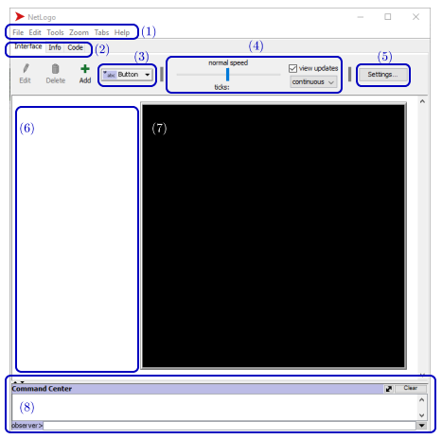
NetLogo orientation
Menu
Tabs for Interface, Info, Code view
Adds widgets to interface
Speed slider, update controls
Settings for world display
Screen area for widgets
World, main view of model
Command Center – for interactive code entry and results

Slide 5
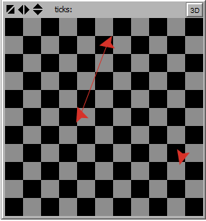
NetLogo entities
Patches have fixed locations
Black/grey in image
Typically used for physical environment
Provide coordinate system for turtle locations
Turtles make decisions
Red darts in image
Are mobile
Spatially aware
Links describe relationships between turtles
Red line in image
Building an ABM

Slide 6
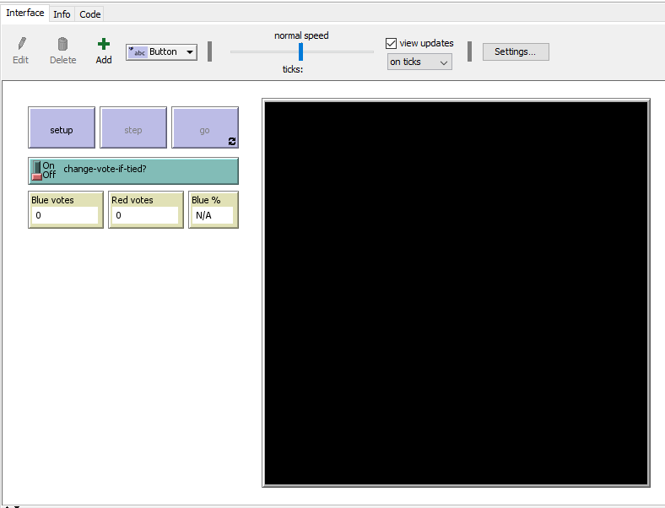
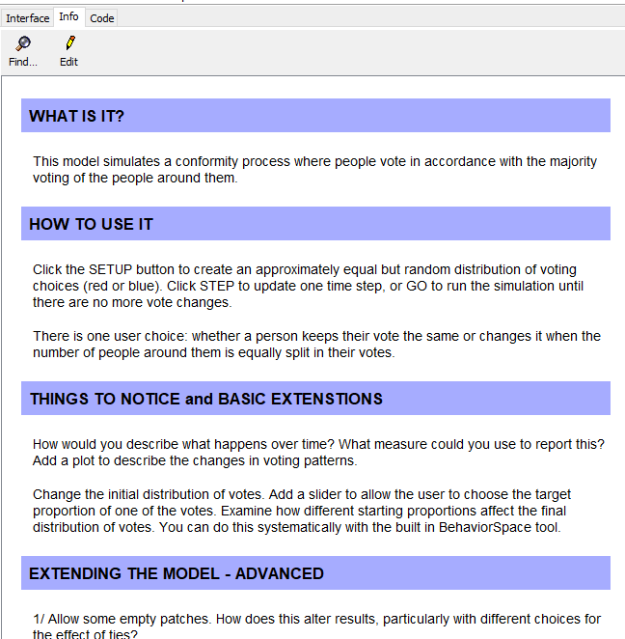
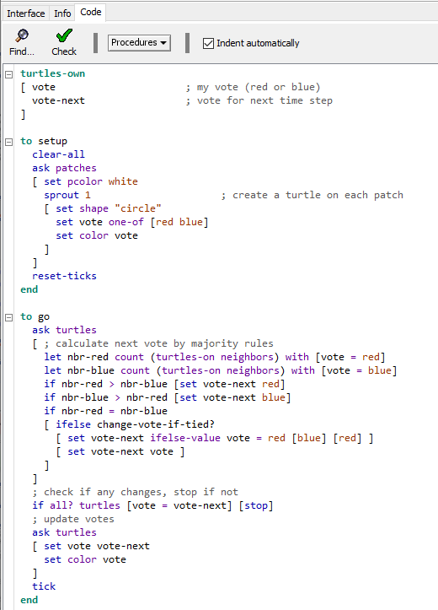
Open Conformity model
Model interface
Model information (if modeller documents)
Code (in NetLogo language)

Slide 7
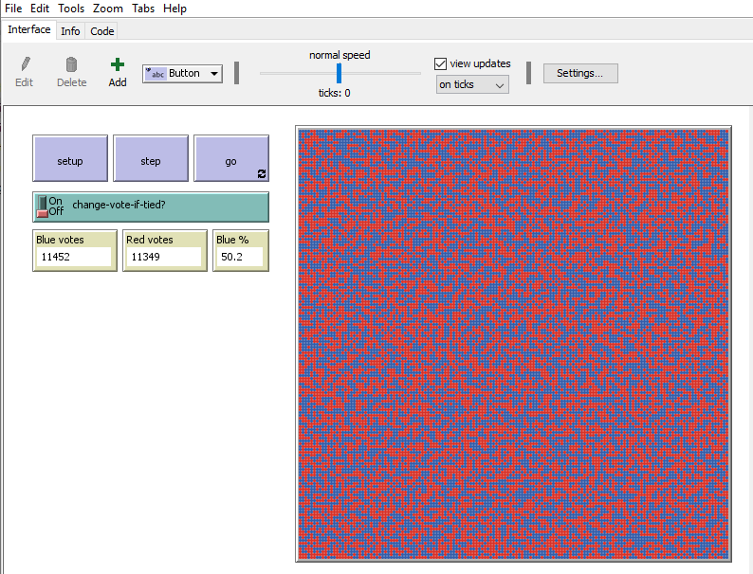
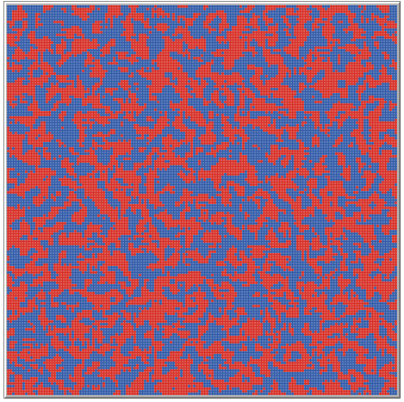
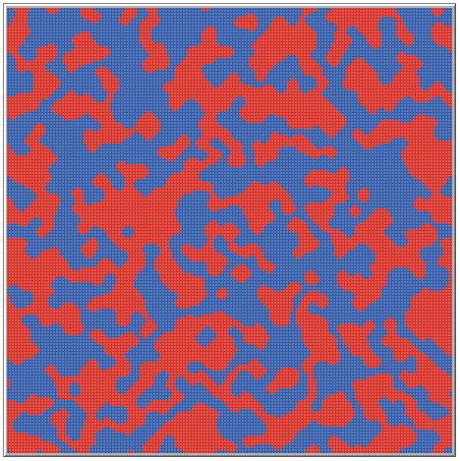
Try it out
Press setup
Press step a few times
Press go
Repeat…
Change the switch
Discussion: what’s happening?
setup
step
go

Slide 8


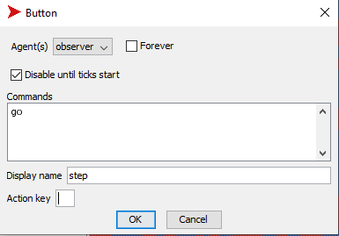
Modular code
Each procedure is made up of primitives and other procedures
named procedure
to <name>
…
end
in order from calling procedure
named procedure
to <name>
…
end
named procedure
to <name>
…
end
…
named procedure
to <name>
…
end

Slide 9
What does ‘setup’ do?
Defines the set of attributes available to each agent (turtle)
Deletes and clears
Each patch in random order, run the block of commands
Creates a turtle and sets attribute values
Vote variable either red or blue, equal probability
Initialises tick counter (timer)

Slide 10
What does ‘go’ do?
Each agent in random order, run the block of commands
Counts the red and blue voting neighbours, stores counts
Chooses an action depending on situation
Access switch on interface
Stops if in equilibrium (all?),
Cancels ‘forever’
Implements chosen action
Advances tick counter (timer)

Slide 11
Time in NetLogo
Procedure
setup
go
go
go
…
reset-ticks
tick
tick
tick
…
Command
Counter (ticks)
0
1
2
3
…

Slide 12
How is the code ‘doing’ ABM?
Simulation
State changes: which turtle voting what
Passage of time: tick counter
Autonomous decisions
Each turtle makes its own decision based on own situation
Heterogeneity
Some voting red, some blue
Interaction – social
Next vote influenced by the votes of the nearby turtles

Slide 13

Extending the model: output
What output do we have?
Extended output
Current time step
World, showing vote location
Number of red / blue votes
Calculated blue %
Some measure of concentration
Proportion blue has minimal change, but clearly the pattern changes
Simple measure: proportion of agents that are completely surrounded by agents who vote the same way
Formal measures available
Segregation index over neighbourhoods
Cluster sizes
Plot over time
What would be useful?
How would you describe the results of the model to someone who couldn’t see it?
What features do you want to capture?
Small group discussion (5 mins)

Slide 14
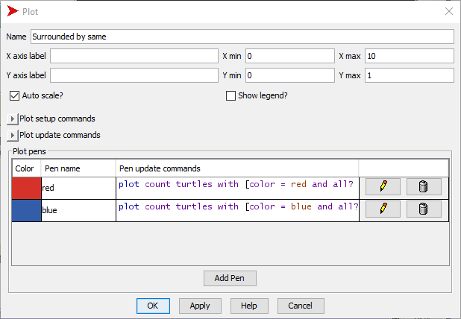
Making the plot
Add plot (interface widget)
(3) in NetLogo orientation slide
Use ‘select’ to move or resize
click to choose colour
click to expand text box (and then drag border to expand further)
extra row
plot count turtles with [color = red and all? turtles-on neighbors [color = red] ] / count turtles with [color = red]

Slide 15
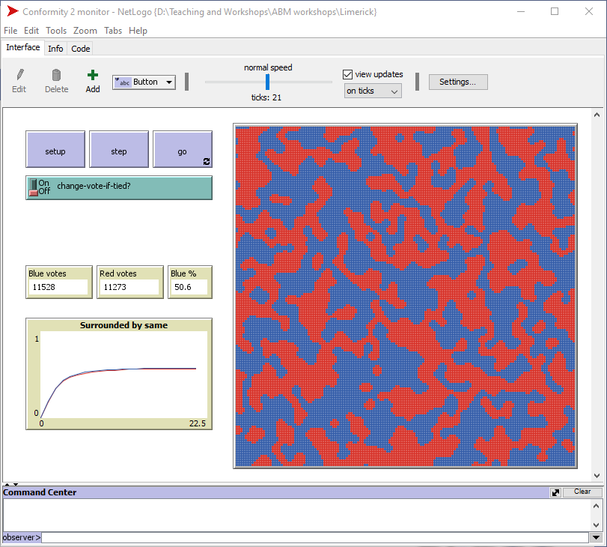
What happens now?
Two lines

Slide 16
Extending the model
Discussion
What could we change to ask more interesting questions?
Small groups for ideas

Slide 17
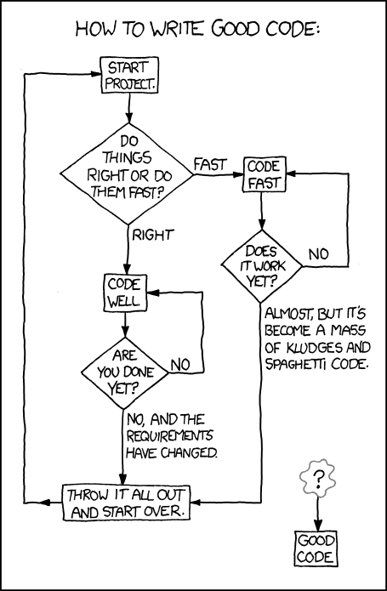
Each choice requires the mechanism to be fully specified
Start with different blue/red mix
This is the one we will build
Heterogeneity in number of influencing agents
Allow some empty patches, or more agents per patch
Agents vary by how far they can see, not just neighbours
Heterogeneity in influence (current has equal contribution by all)
Additional attribute of ‘charisma’
Sum of charisma rather than count of votes
Additional voting choice (colour)
What does majority mean?
Source: Randall Munroe, xkcd comics http://xkcd.com/844/

Slide 18
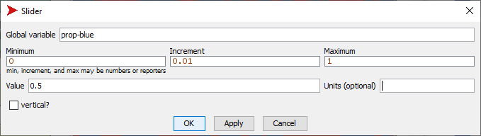
User control for starting distribution
Create slider for prop-blue
Another interface widget
Sliders allow users to set the value of some (global) variable

Slide 19
Using this variable in the model
Slider makes a variable available: proportion of blue voters initially
What procedure needs to use this variable?
What code needs to change?
What does the code need to do? (Design, mechanism, logic)
Be specific

Slide 20

Use the model

Slide 21
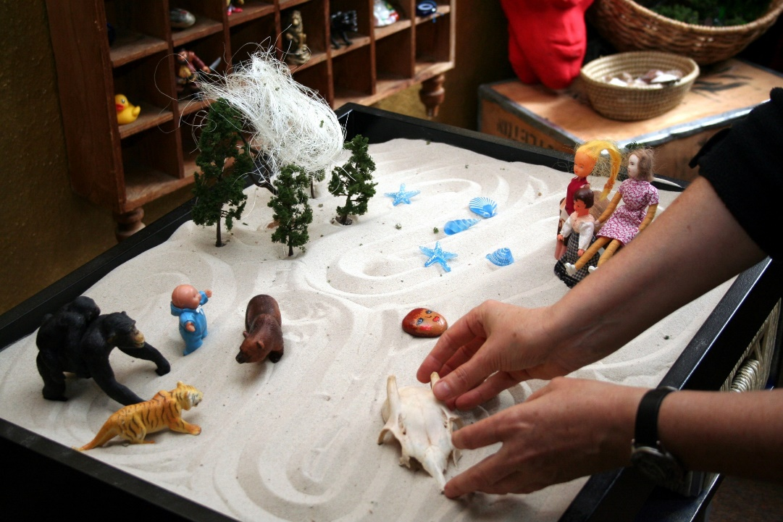
Play with the model
What happens with different starting proportions?
What starting proportion is needed for both groups to exist?
How would you describe the pattern of blue proportion over time?
What is the relationship between starting proportion and:
Final proportion?
Final concentration?
Do patterns change as inputs change?
Try some values!
Need more tools

Slide 22
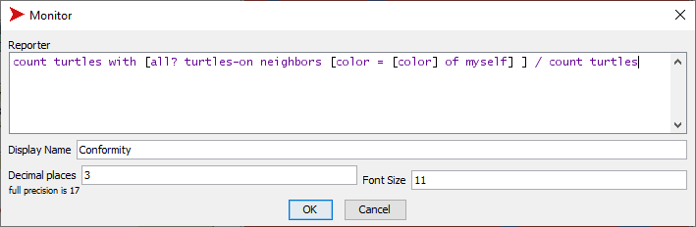
Additional output: conformity monitor
Monitor is a widget the reports the results of a calculation
Similar code construction as the plot of surrounded
But sums the red surrounded and blue surrounded

Slide 23
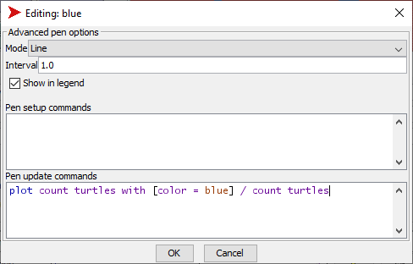
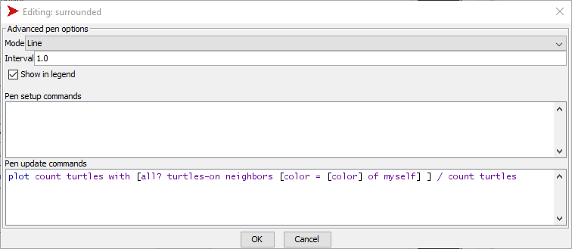
Revised plot
Revise plot pens
Conformity: copy the code from the monitor (and add ‘plot’ to front)
Blue: make it proportion blue
Tick the legend box

Slide 24
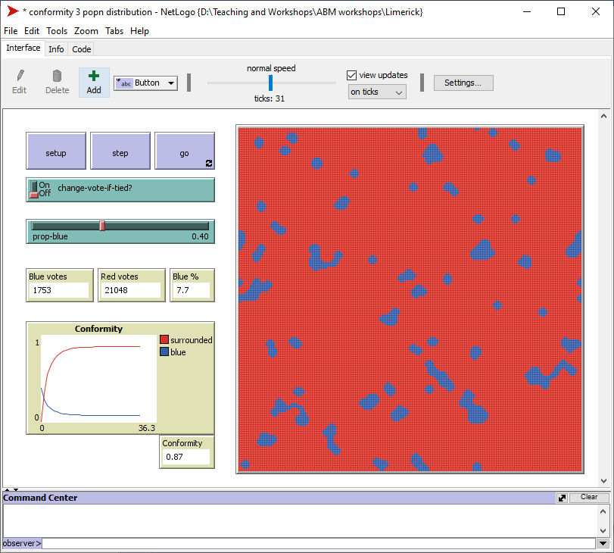
Revised model

Slide 25
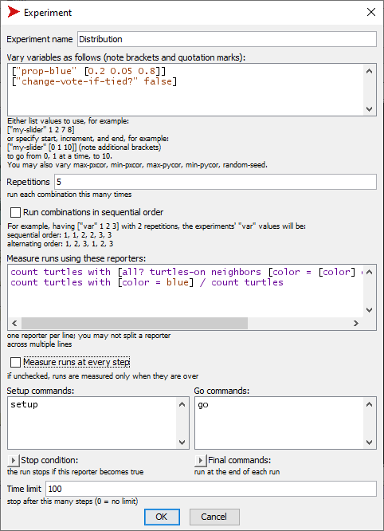
Experimentation
name the setup
input sequence
fix all others
BehaviorSpace to examine
input: prop-blue
fix switch to off
output: conformity, blue
Open BehaviorSpace (Tools)
New experiment
Save (OK)
# simulations
outputs
all or end?
procedures
stop test
stop tick

Slide 26
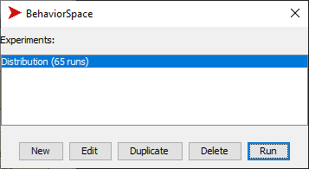
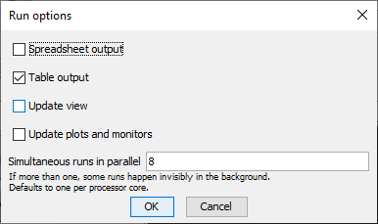
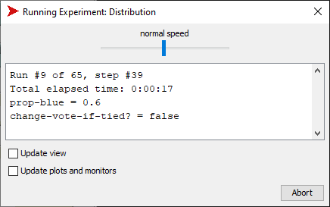
Running BehaviorSpace
run button
dialogue box for file name
table output
uncheck for speed
progress

Slide 27
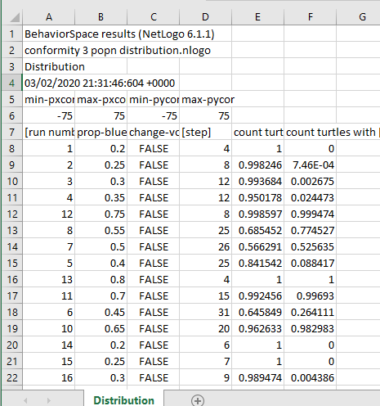
Structure of BehaviorSpace table
Top
4 lines file info
2 lines world size
Body
column with run number
column(s) for parameter values
column for step number
In this case, gives ticks until equilibrium reached
column(s) for reporters

Slide 28
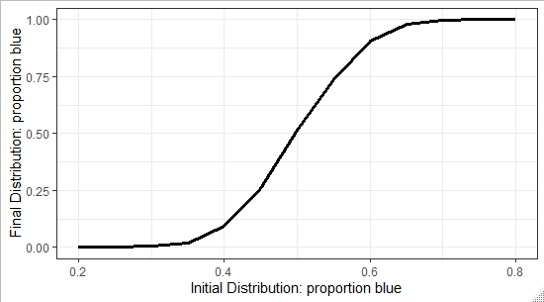
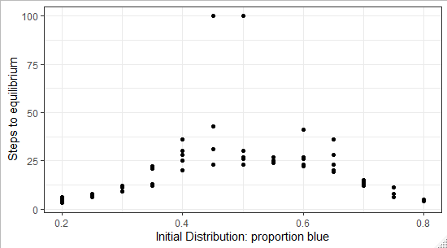
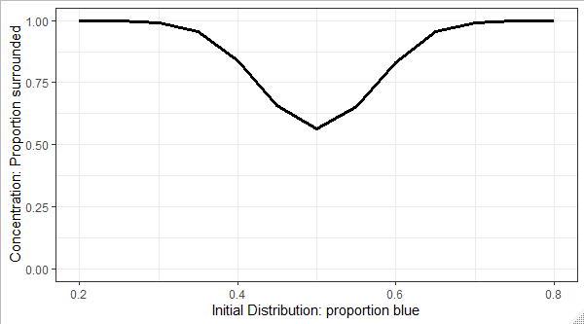
Analyse results

Slide 29
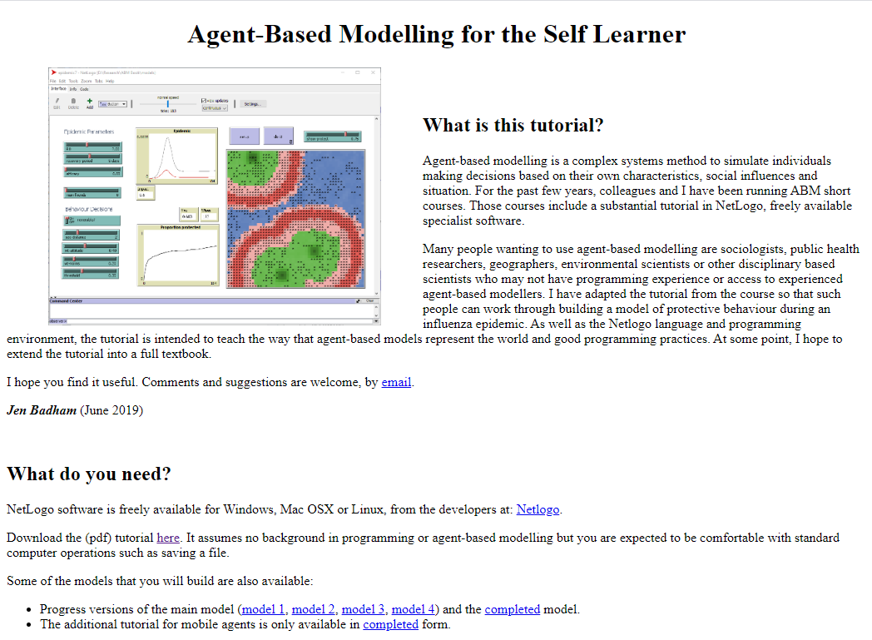
If you want to learn NetLogo…
https://jbadham.biz/Research/ABMBook/

Slide 30

Key Ideas

Slide 31
Modelling a complex system
Concepts
When to use ABM
Complex system: Behaviour arises significantly from interactions
Model: Simplified representation of features and relationships
Simulation
Model of a process
States change over time
Simulation of a complex system describes some theory about state changes that involves interactions
ABM only one method for modelling complex systems
ABM used where:
Autonomous individuals (agents)
No central control
Agents interact with each other and/or their environment
Local effects
Agents are diverse
Heterogeneity contributes to different actions

Slide 32
Why NetLogo for ABM?
Easy to learn
No other language
Small command set for most requirements
Models are quick to write
Integrated interface and code
Few lines of code
Sufficiently powerful
Suitable for up to about 50,000 agents
Clunky graphics
Reminds users that they are working with a model, not a predictive tool

Slide 33

Models assist insight
Tool for thinking: Agent-based model captures some theory of process and allows us to examine the implications of that theory

